Slide 1
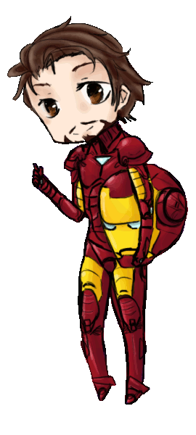
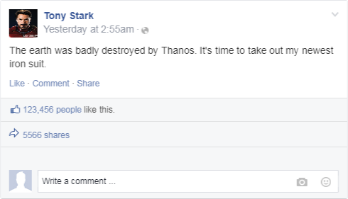
What did Tony do this morning?

Slide 2
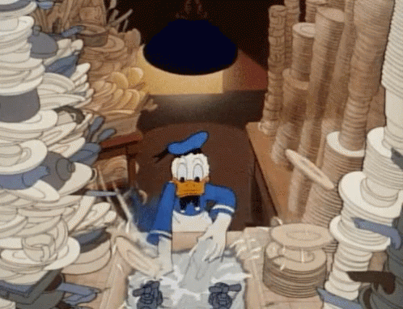
washed the dishes
wash the dishes
〔t〕

Slide 3
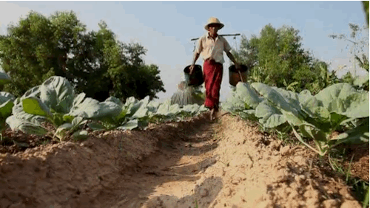
watered the plants
water the plants
〔d〕

Slide 4
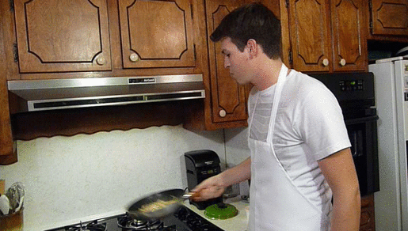
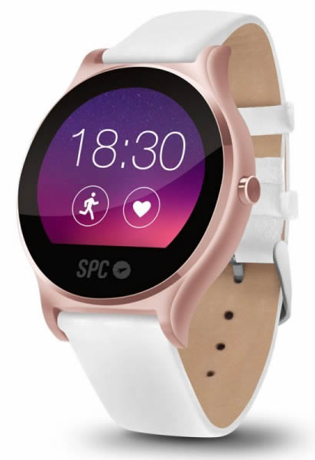
cooked dinner
cook dinner
〔t〕

Slide 5
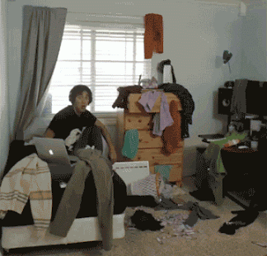
clean my room
cleaned my room
your
his
her
our
their
Mandy’s
〔d〕

Slide 6
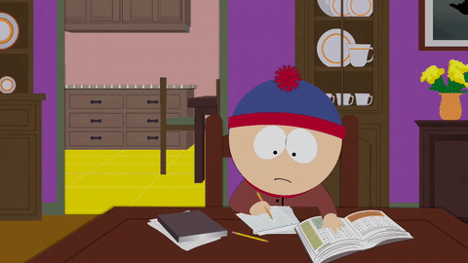
do his homework
did his homework
my
your
her
our
their
Curry’s

Slide 7
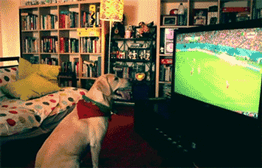
watched TV
watch TV
〔t〕

Slide 8
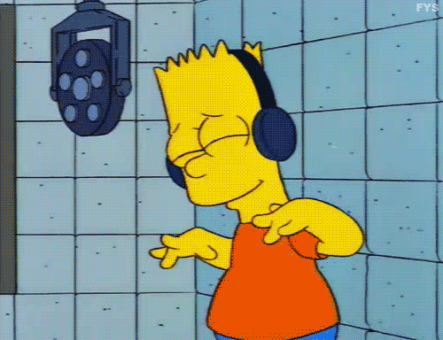
listened to music
listen to music
〔d〕

Slide 9
規則過去式動詞發音

Slide 10
ed有三種發音
1.字的結尾發音喉嚨有震動→ 〔d〕
2.字的結尾發音喉嚨無震動→ 〔t〕
3.字的結尾是t或d→ 〔Id〕

Slide 11
washed
cooked
cleaned
watered
watched
listened
〔Id〕
〔d〕
〔t〕

Slide 12
washed the dishes
2
3
1
watered the plants
cooked dinner
cleaned my room
6
listened to music
4
did his homework
7
5
watched TV

Slide 13
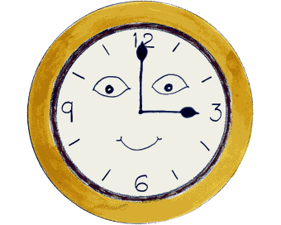
Let’s learn some past time!!

Slide 14
last night
May
6th
May
7th

Slide 15
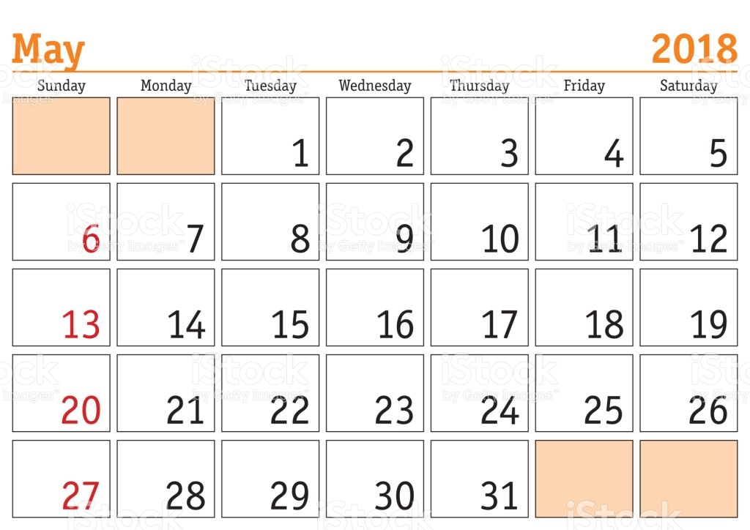
last weekend
today

Slide 16
Unit 1中出現哪些表示過去的時間:
yesterday
2.yesterday morning
3.then
4.yesterday afternoon

Slide 17
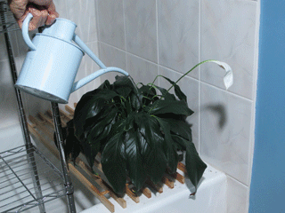
What did you do last night?
I watered the plants last night.

Slide 18
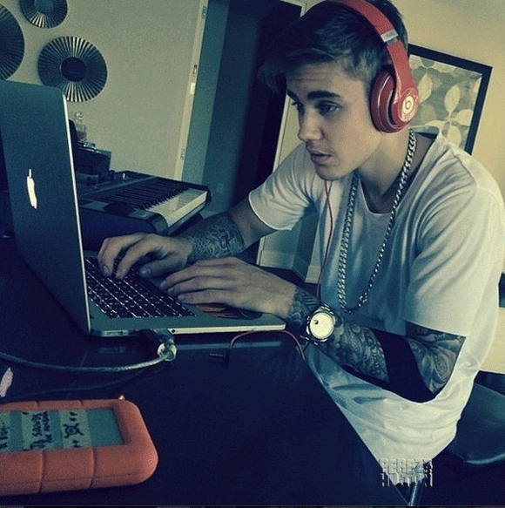
What did he do last weekend?
He listened to music last weekend.

Slide 19
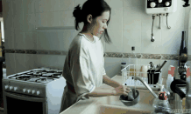
What did she do yesterday?
She washed the dishes yesterday.

Slide 20
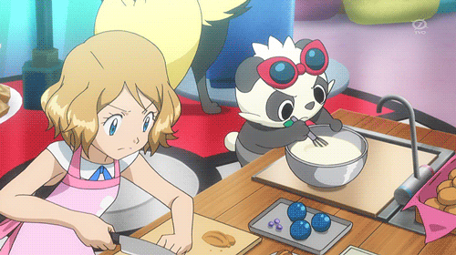
What did they do yesterday afternoon?
They cooked dinner yesterday afternoon.

